Slide 1
How to Complete the Updated Recertification Form

Slide 2
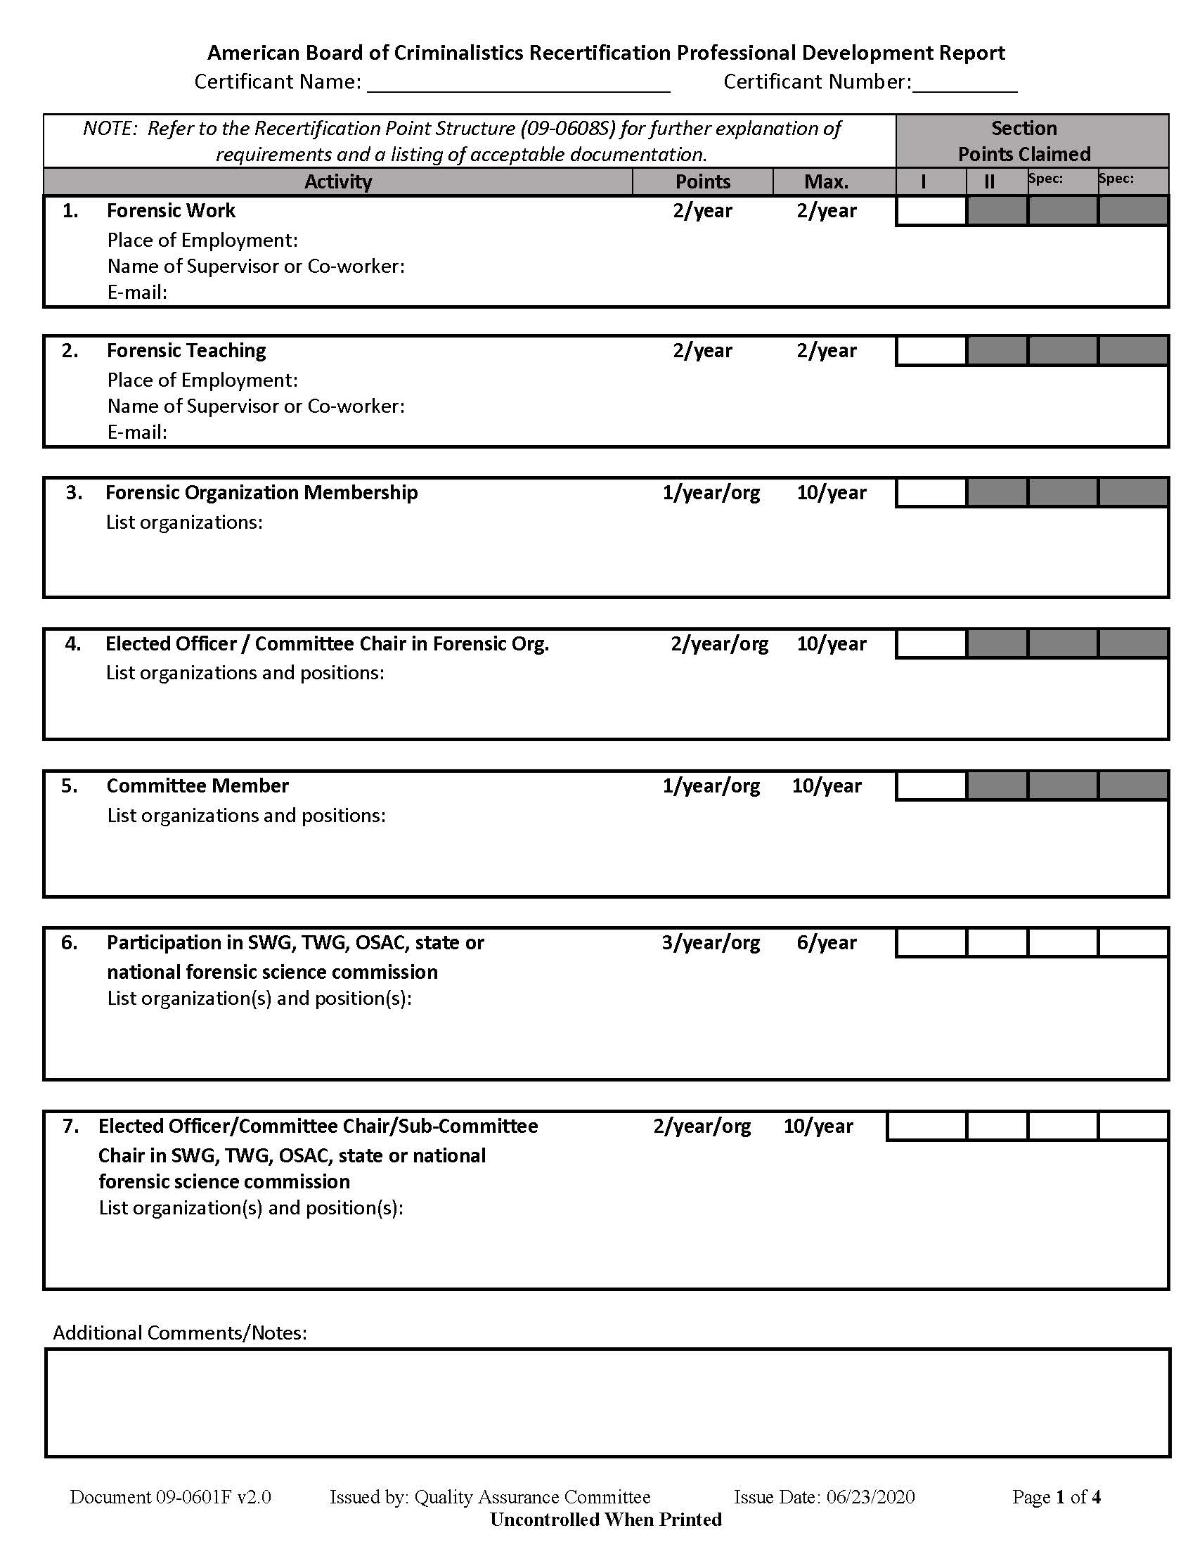
Make sure to include your name and certificant number.

Slide 3
Note the dropdown options for specialty columns. Select the specialty you wish to claim points for and claim those specialty points in the same column throughout the form. If you have more than two specialties in which you are claiming points, you will need to complete a second form.

Slide 4
You will need to refer to the Point Structure Document (09-0608S) for clarification on activities and expected supporting documentation.

Slide 5
The forms have been combined so you may claim general recertification and specialty points on the same document.

Slide 6
The text boxes have been left open for free-form text. Please make sure to include the requested information on the form.

Slide 7
Note that you cannot claim points in a particular section if the box is grayed out.

Slide 8
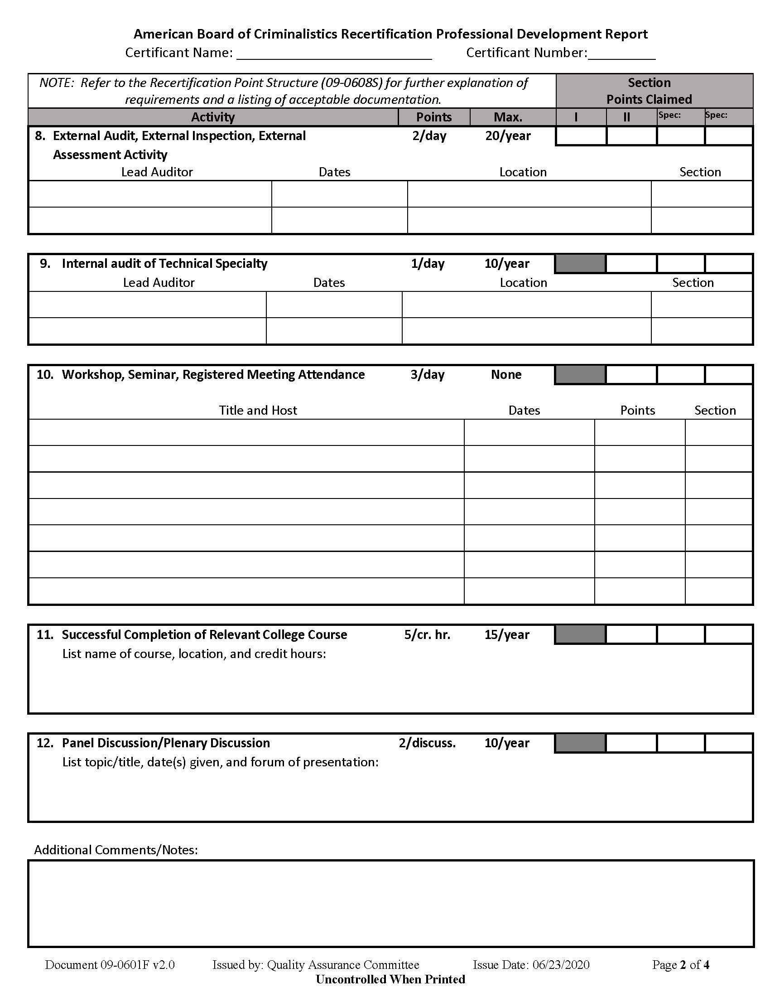
Claim total points per section per activity in these blocks.

Slide 9
For some areas, we have included a table for you to complete. In this table you will need to select which section you choose to apply the points to. You will need to manually tabulate the total points per section per activity and enter the total in the blocks provided.

Slide 10
An additional comments/notes field has been added to each page. You can use this field to:
add clarification
add more activities than you have space for
NOTE: if you want a particular workshop, seminar, etc. claimed towards more than one specialty
PLEASE make sure to include all points claimed for a particular activity in the total blocks, even if you note the activity in the additional comments field.

Slide 11
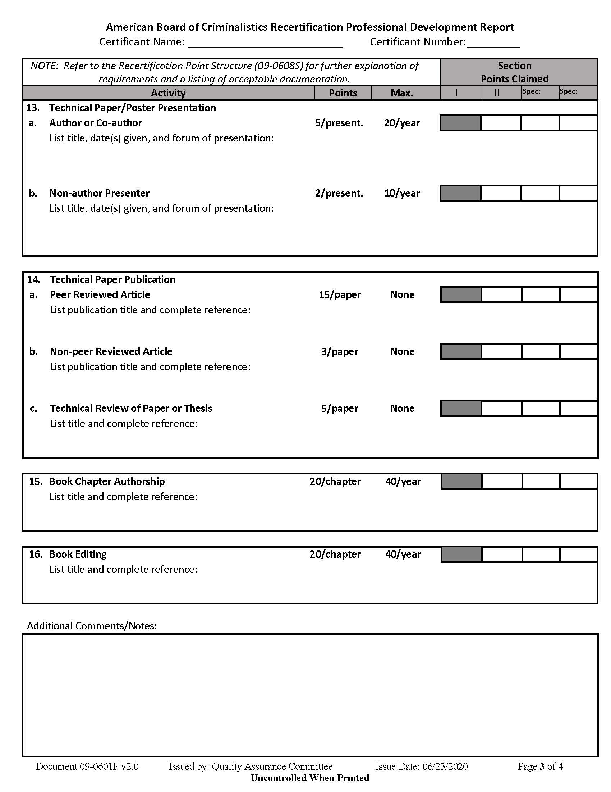
Instructions for Page 3 are similar to pages 1 and 2.

Slide 12
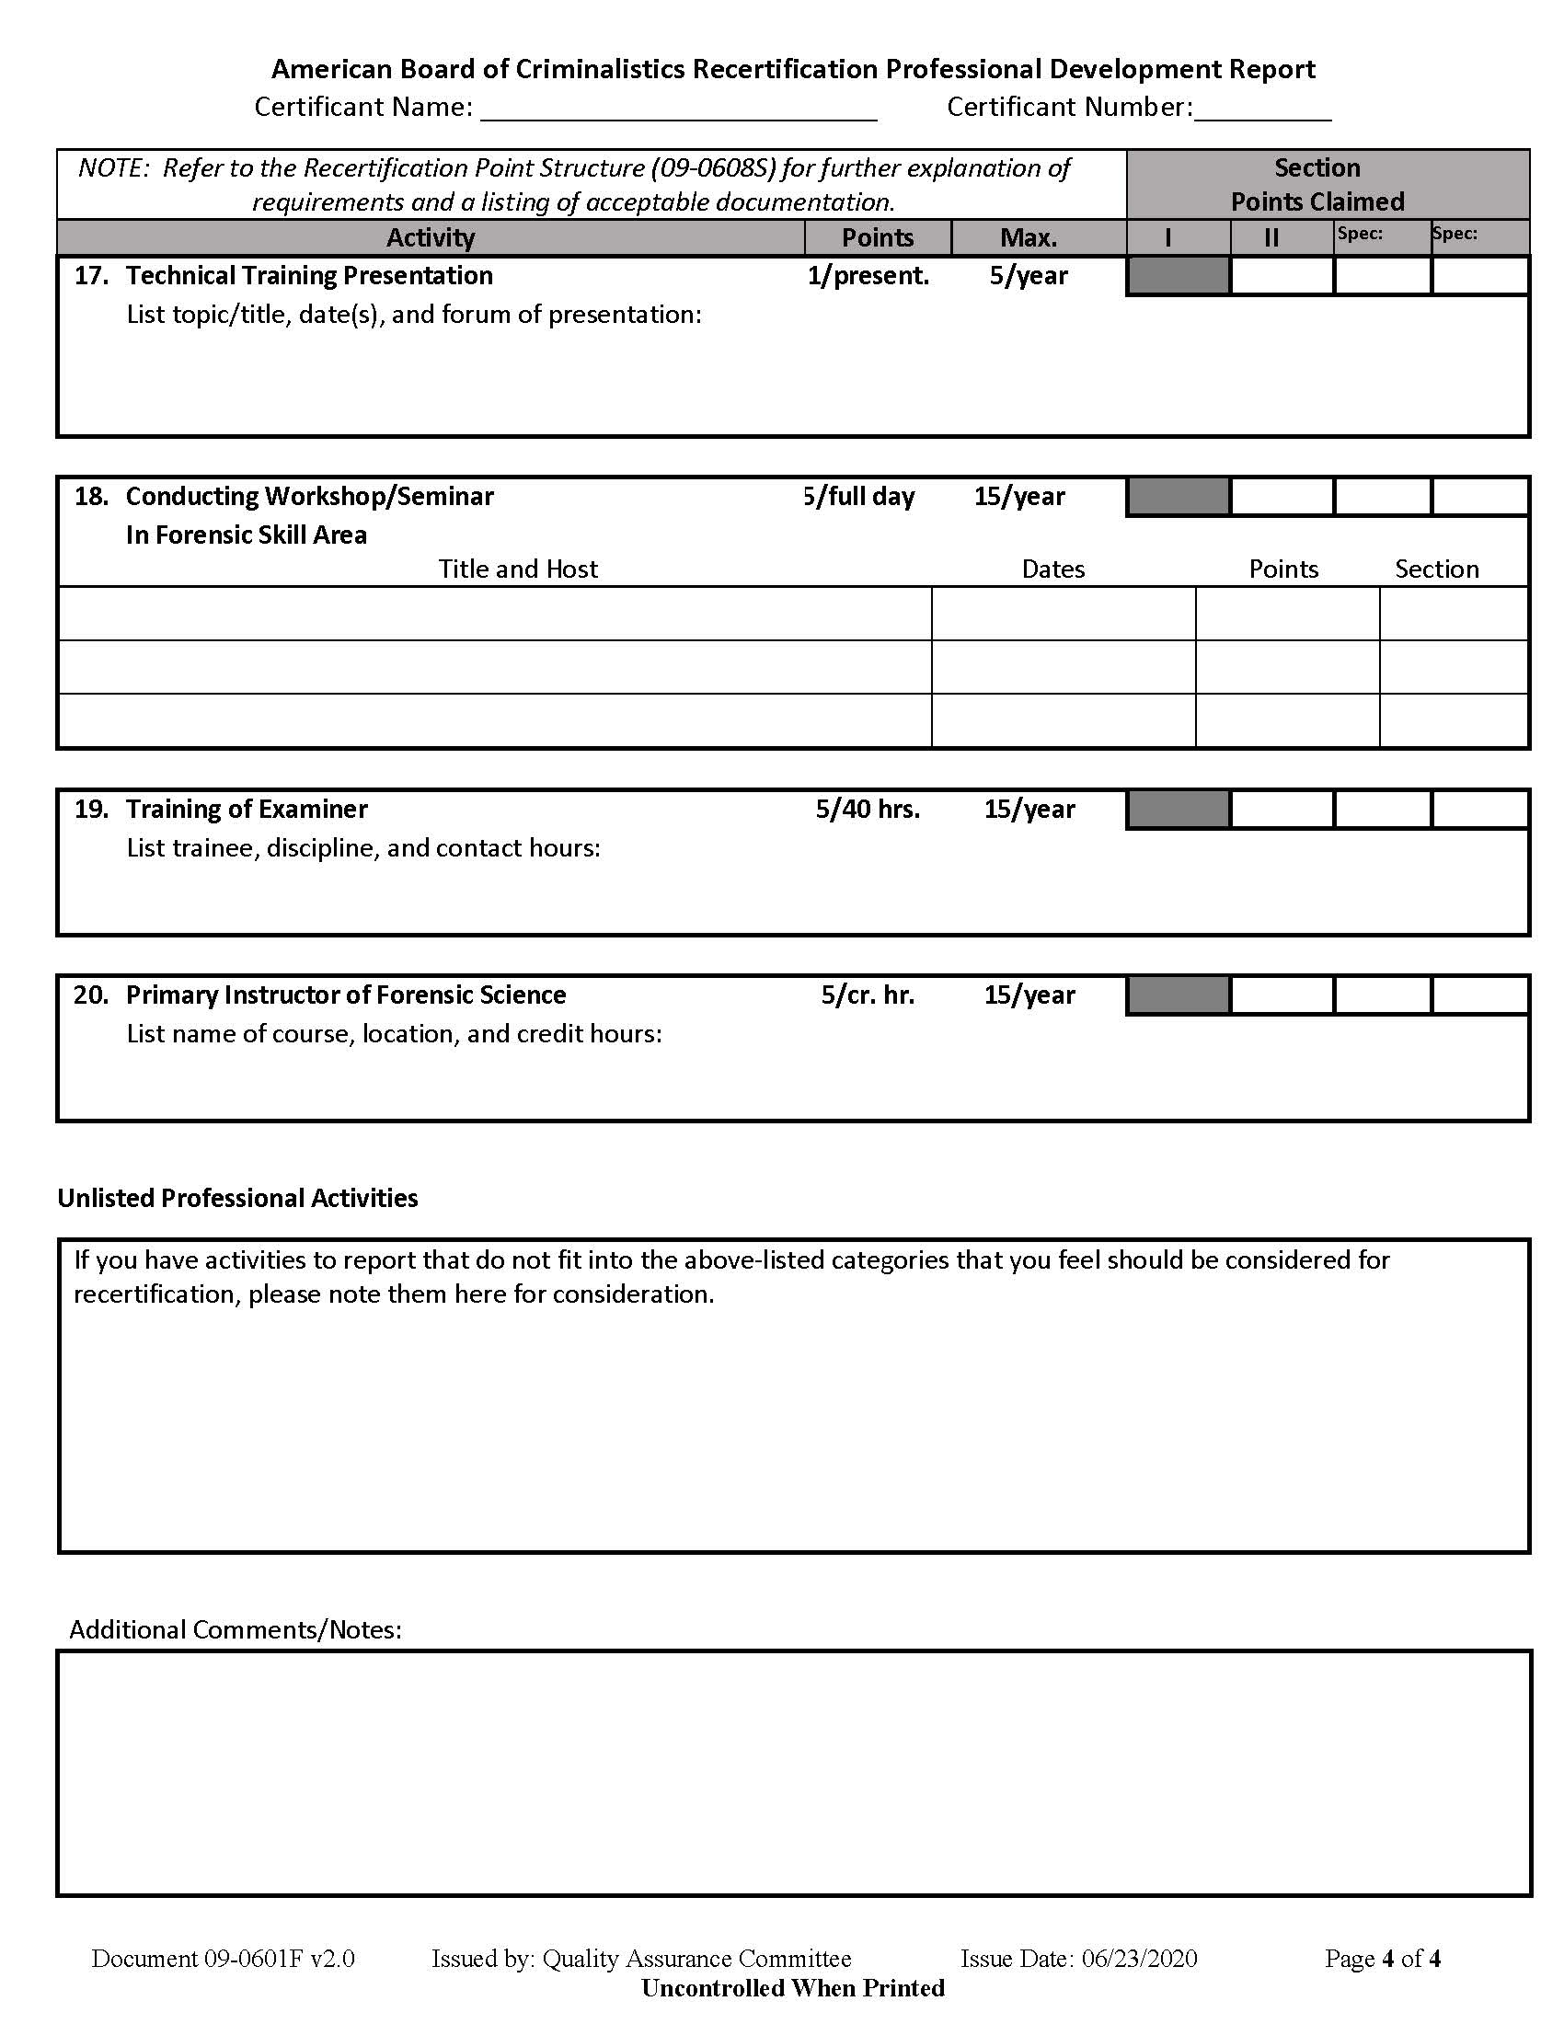
Note the block for Unlisted Professional Activities: If you have an activity that you believe should be included, but is not listed on this form, please note it here with enough information that the Recertification Committee may make a decision. You may be contacted for further information and/or documentation.

Slide 13
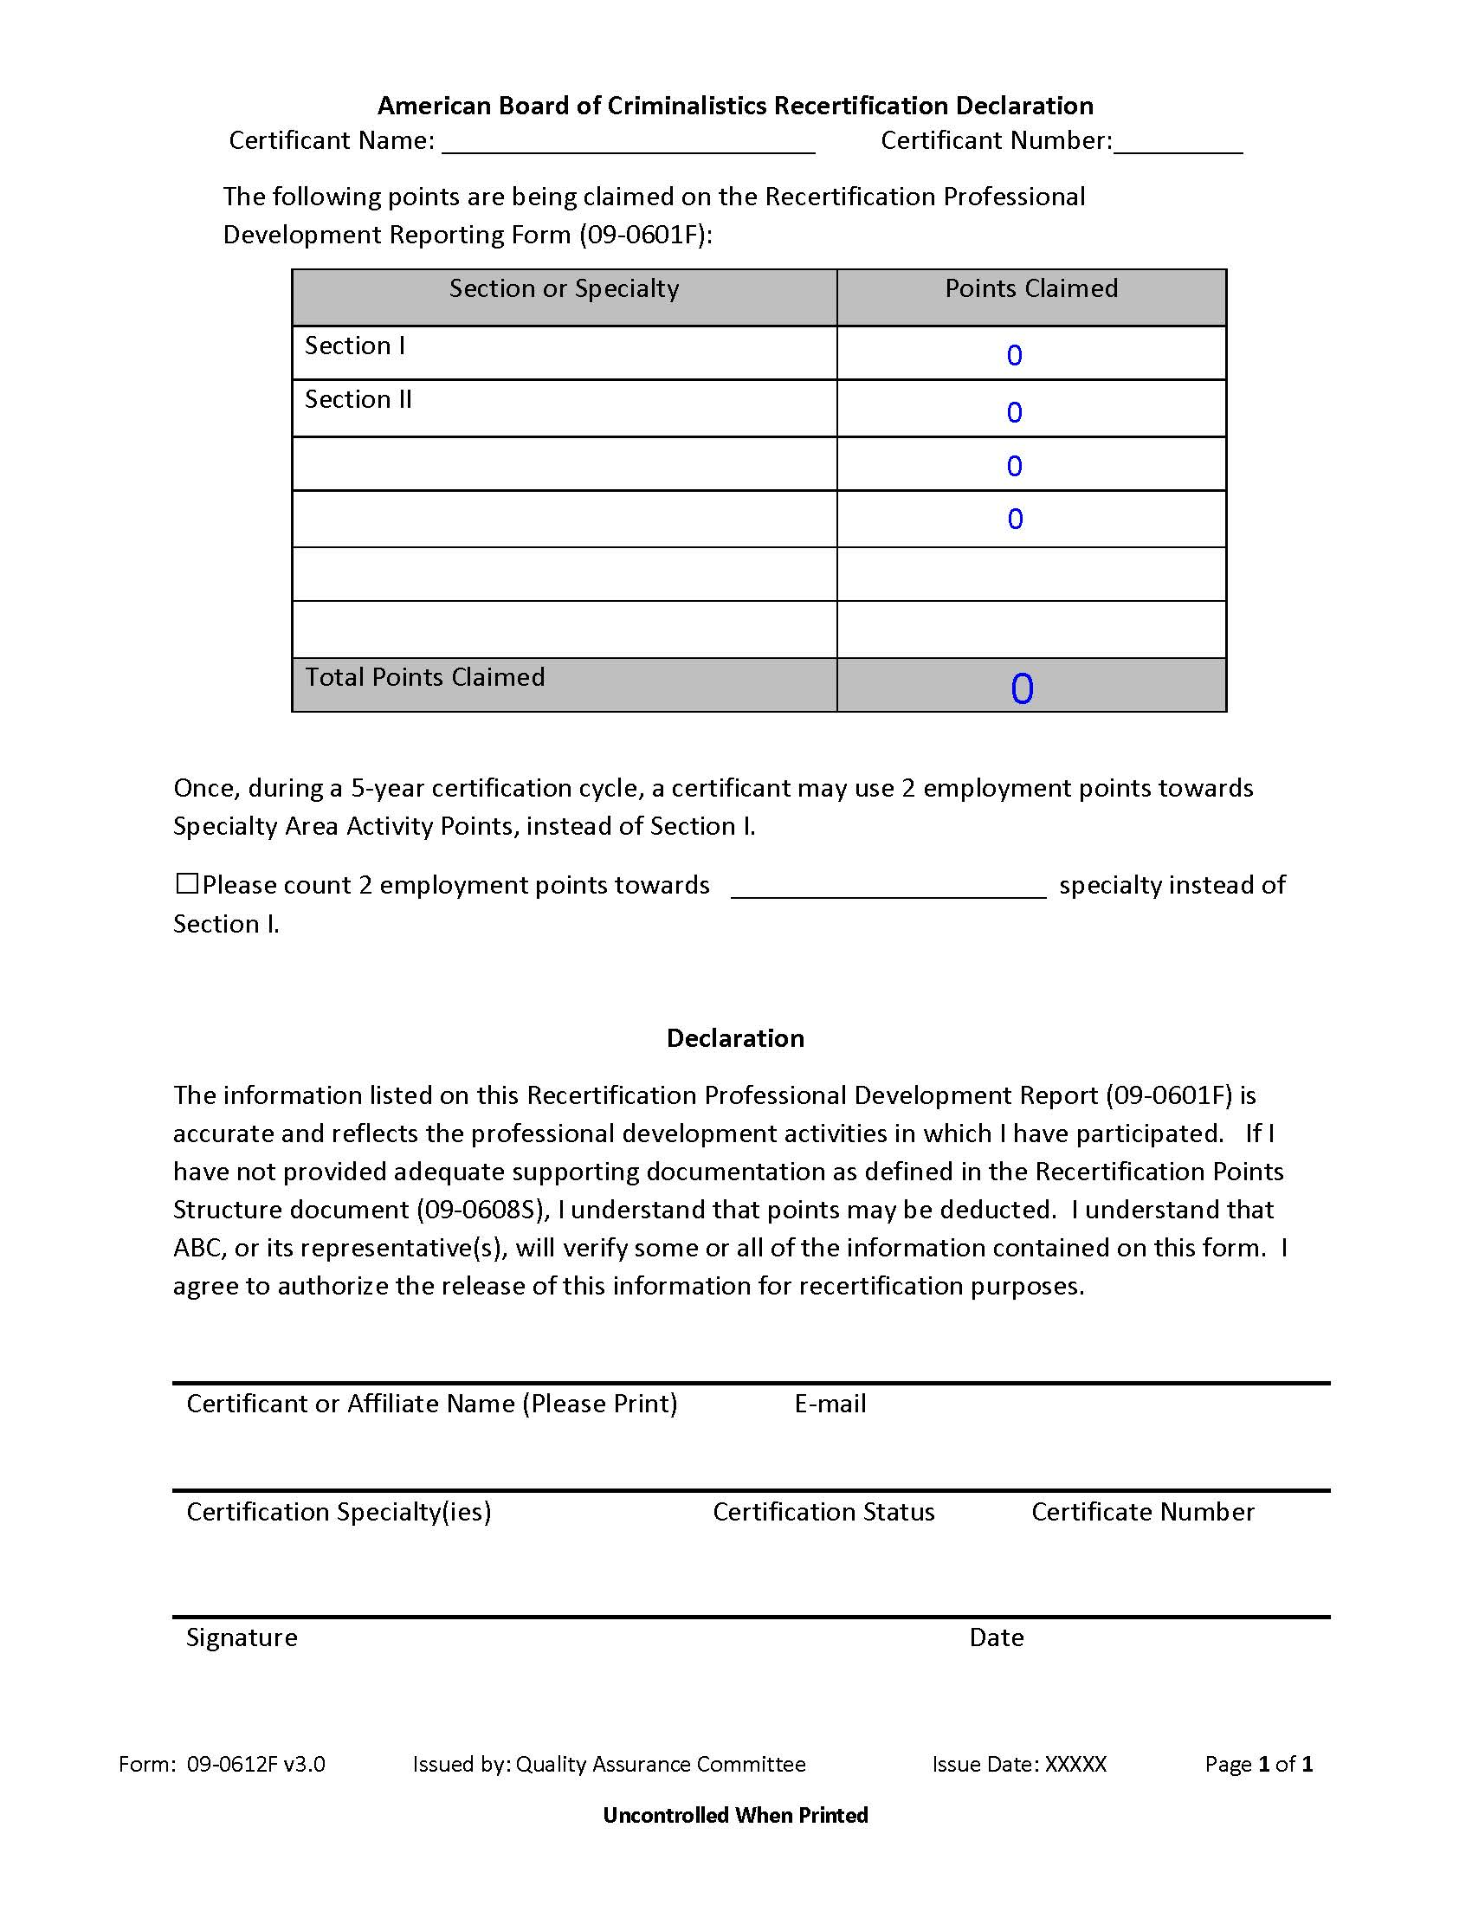
The Declaration Form (09-0612F) has been included with the Recertification Professional Development Report(09-0601F) for convenience. Both forms need completed for claiming points. If you are submitting points for more than two specialties, you only need to submit one Declaration Form. Manually enter the specialties and points claimed in the last two lines of the table.

Slide 14
The points will automatically tabulate.

Slide 15
You may request to move points on this form.

Slide 16
There is NO LONGER a requirement that a supervisor sign your form. Unless you are a contractor or have intermittent employment, you do NOT need to supply an Employment Verification Form (09-0610F).

Slide 17
Please note that the following has been added to the Declaration Form for your 2021 submission:
COVID-19 RESPONSE
The ABC is granting all certificants 10pts for the 2020 recertification year due to the impact of COVID-19 may have had on certificants’ ability to obtain points through training and other forensic skill building activities. These 10 points will default to Section II if no further action is taken and if you have not yet met your required points for your current certification cycle. If you prefer to allocate some of these points elsewhere, please indicate so below. You may move any or all 10 points to Section I. You may move a maximum of 5 points to a Specialty. If you have more than one specialty, you may still only move a maximum of 5 points to be split among your Specialty Sections as you indicate below.
☐ Please count _____ points towards Section I.
☐ Please count ____ points towards ______________________ specialty.
☐ Please count ____ points towards ______________________ specialty.

Slide 18
IF YOU ARE REPORTING MORE THAN TWO SPECIALTIES:
You will generally need to complete a second Recertification Professional Development Report.
Note that the electronically fillable fields may get overwritten if you combine a second form that still has electronically fillable fields. You will need to print and scan your second form or print to PDF and then attach the second form to the first.
You only need to complete one Declaration form.
If you have only a single activity or two that you wish to be counted towards your recertification points in a third specialty, you may note that activity, with the appropriate information, in the additional comments field on the appropriate page. Make sure you include the points in your declaration page.

Slide 19
You may still manually complete the forms, using the same guidance in this presentation.
While we encourage electronic submission of the forms, you may still mail them to:
ABC Registrar P.O. Box 1358 Palmetto, FL 34220

Slide 20
You must annually sign the Rules of Professional Conduct (09-0001F). Effective January 1, 2021, these will now be signed electronically on our website.
A physical signature is required and can be applied using a touch screen or just using your mouse to sign in the field.

Slide 21
We value our certificants. We have worked to make the recertification process clearer, cleaner, and more user-friendly.
For the immediate future, the electronic submission process will include only the submission of the fillable .PDF document (seen in this presentation). We have discontinued the use of the electronic form.
As we continue to improve our processes, we may be including surveys at the end of the recertification submission. We encourage you to use this opportunity to provide feedback.
Additionally, customer satisfaction surveys will be included in the submission of your Rules of Professional Conduct. The surveys will also be available on our website, for those who choose to mail in their packets.
If you have further questions, you may contact:
Registrar: abcregistrar@criminalistics.com
Recertifcation Liaison: recertification@criminalistics.com

Slide 22
THANK YOU!!

